Slide 1



National Disaster Risk Management
Program
NDRMP
Belgrade, March 4 2015

Slide 2




Floods May 2014
Total needs for recovery and reconstruction estimated at 1.345 billion EUR
Lessons Learned
Republic of Serbia needs to:
Develop a systemic approach towards risk reduction and management
Undertake activities and measures on strengthening prevention
Plan and implement investments based on understanding risk
Ensure the highest possible level of protection of lives and assets from new floods and other natural disasters
Reduce risk and damages of natural disasters

Slide 3
Objectives
The objective of the National Disaster Risk Management Program is to support the Government of Serbia to build a comprehensive program for disaster resilience.
Program will be used as an umbrella framework to coordinate, channel funds, and implement activities related to reducing and managing disaster risks in Serbia.
Program will rely on improving coordination of activities between existing structures within the Government.
Program will be coordinated by the Government Office for Reconstruction and Flood Relief in collaboration with:
  Ministry of Interior
  Ministry of Agriculture and Environmental Protection
  Ministry of Public Administration and Local Self-government
  Ministry of Construction, Transport and Infrastructure
  Ministry of Finance
  Serbian Government European Integration Office

Slide 4
Program Structure
Administration and Supervision of the Program
World Bank
GFDRR
UNDP
WB Local
Government
Capacity
Building
European
Union Serbia
IPA Funds
GFDRR
Serbia Window
Swiss SDC
Swiss SECO
Steering
Committee
Donors
and
Ministers
NATIONAL
DISASTER RISK
MANAGEMENT
PROGRAM
Facilitating the
establishment
of the Program
Flood Relief Office
Technical
support
Donors
UN (UNDP)
World Bank
Component 1 - Institution Building
Across component 2-5
Component 2
Risk
Identification
Component 3
Risk Reduction
structural and
non structural
Component 4
Preparedness, Response,
Early Warning
Component 5
Risk Financing
Strategies
Component 6
Resilient
Recovery
National Institutions Implementing Activities

Slide 5
Funding Mechanisms
The Program will be funded through different grant sources. At the moment, the main sources identified are:
US$ 0.5 million
US$ 0.5 million
€0.2 million
€0.4 million
€0.5 million
€6.1 million
Global Facility for Disaster Reduction and Recovery under the World Bank: US$ 0.5 million
European Union (EU) Instrument for Pre-Accession Assistance (IPA) 2014: €6.1 million
Swiss State Secretariat for Economic Affairs (SECO) Disaster Risk and Insurance: €0.5 million
Swiss Agency for Development and Cooperation (SDC): €0.4 million
World Bank - Austria Urban Partnership Program: €0.2 million
United Nations Development Programme (UNDP): US$ 0.5 million
US$ 9.0 million
or
EUR 8.0 million
Total amount already identified is around
EUR 8.0 million or US$ 9.0 million.

Slide 6
Components
Component 1 - Institution Building
Across component 2-5
Component 2
Risk
Identification
Component 3
Risk Reduction
structural and
non structural
Component 4
Preparedness Response,
EWS
Component 5
Risk Financing
Strategies
Component 6
Resilient
Recovery
1 - Institution building: for consultation, coordination and capacity building, etc.
2 - Disaster risk identification and monitoring: for identifying and assessing risks, improving hazard monitoring and forecasting, etc.
3 - Structural and nonstructural risk reduction: for risk reduction activities including flood protection, improved land use planning and building codes, etc.
4 - Early warning systems and preparedness: for improving early warning systems, strengthened emergency response capacities, public education on disaster risks, etc.
5 - Risk financing strategies: for developing risk financing strategies, promoting catastrophe insurance, etc.
6 - Resilient Recovery: introducing international methodology for damage assessment, planning for response and recovery, building back better, etc.

Slide 7

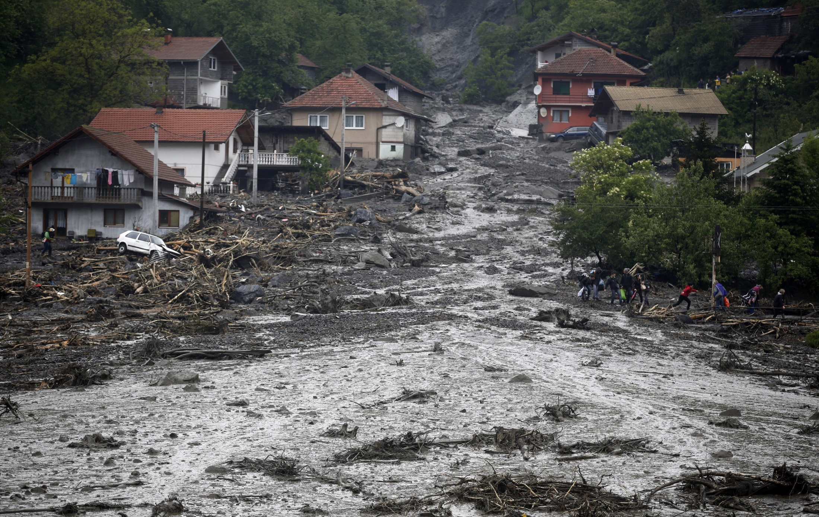

Slide 8
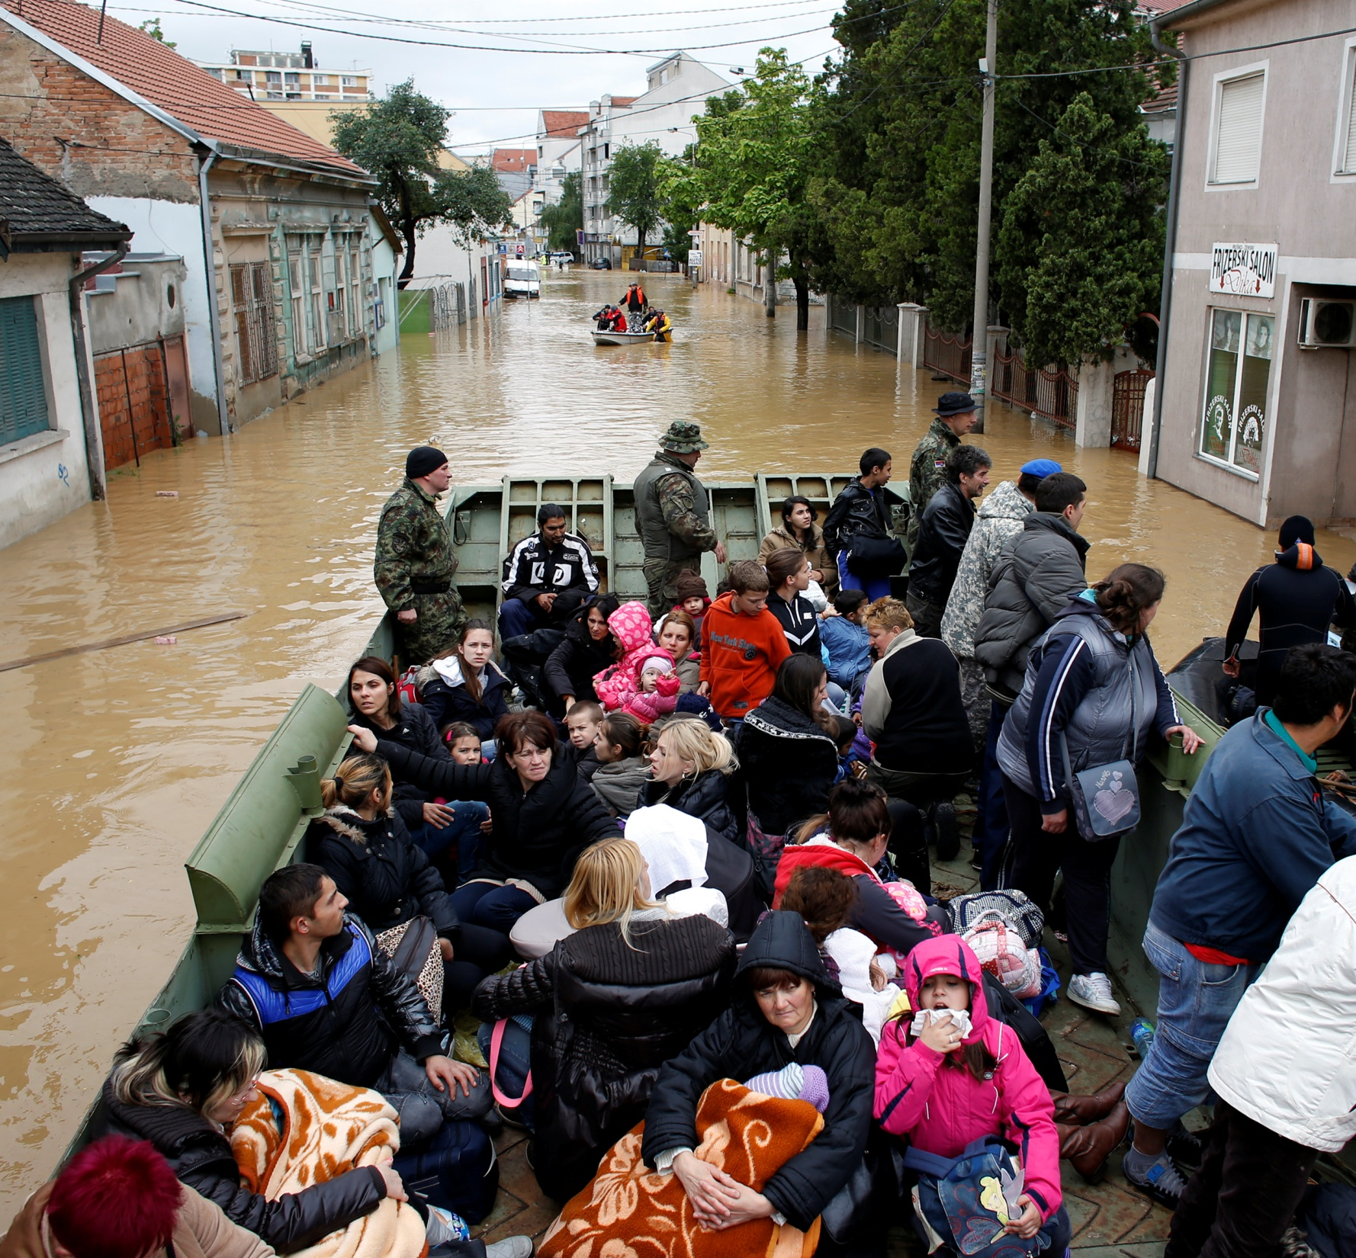

Slide 9

THANK YOU
Belgrade, March 4, 2015

